Slide 1

C++ vs. C#
intro to apis – Class 4

Slide 2


C++
C++ is a general-purpose, object-oriented programming language.
C++ was the first c-family language that introduced the concept of Class and Objects. It was considered “c with classes.”
It was created by Bjarne Stroustrup at Bell Labs circa 1980. C++ is very similar to C (invented by Dennis Ritchie in the early 1970s).
C++ is so compatible with C that it will probably compile over 99% of C programs without changing a line of source code.

Slide 3
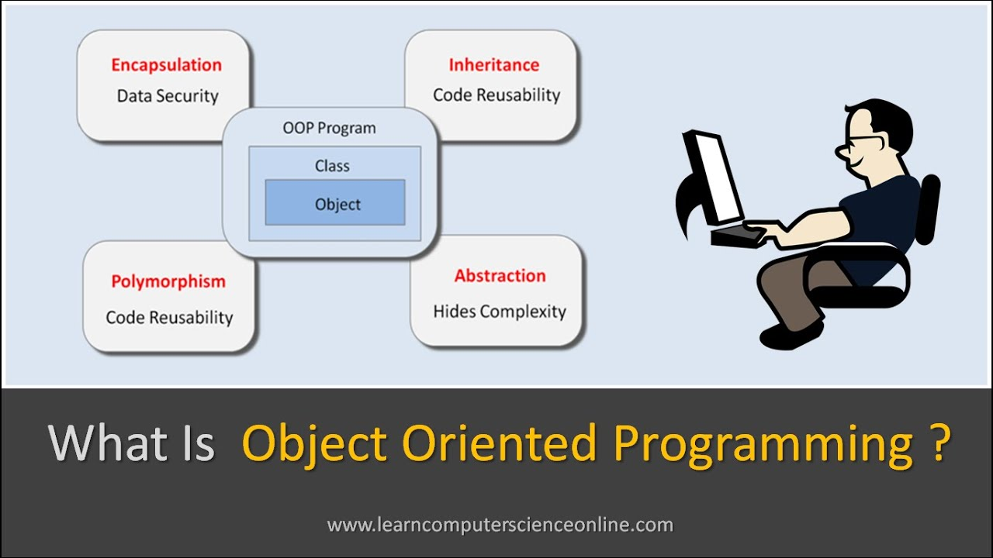
object-oriented programming (OOP)
Object-oriented programming (OOP) refers to a type of computer programming (software design) in which programmers define the data type of a data structure, as well as the types of operations (functions) that can be applied to the data structure.
In this way, the data structure becomes an object that includes both data and functions. In addition, programmers can create relationships between one object and another. For example, objects can inherit characteristics from other objects.

Slide 4
basic object-oriented programming concepts
Abstraction: The process of "showing" only essential attributes and "hiding" unnecessary information.
Encapsulation: the bundling of data, along with the methods that operate on that data, into a single unit. (A class!)
Inheritance: basing an object or class upon another object or class, retaining similar implementation. a feature that represents the “is a” relationship between different classes.
Polymorphism: A programming language’s ability to process objects differently depending on their data type or class.

Slide 5
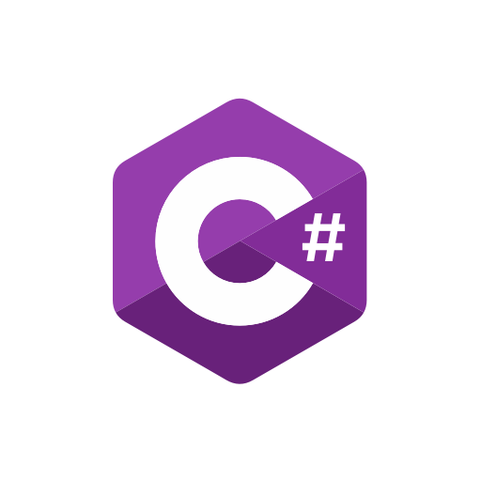
C#
C# was developed by Microsoft in 2002. Microsoft introduced C# along with the .NET Framework and Visual Studio, both of which were closed-source.
C# is considered an object-oriented programming language, but is also considered to be component-oriented.
C++ is now considered a low-level programming language (this is widely debated!) that adds object-oriented features to its base language C whereas C# is a high-level programming language.

Slide 6
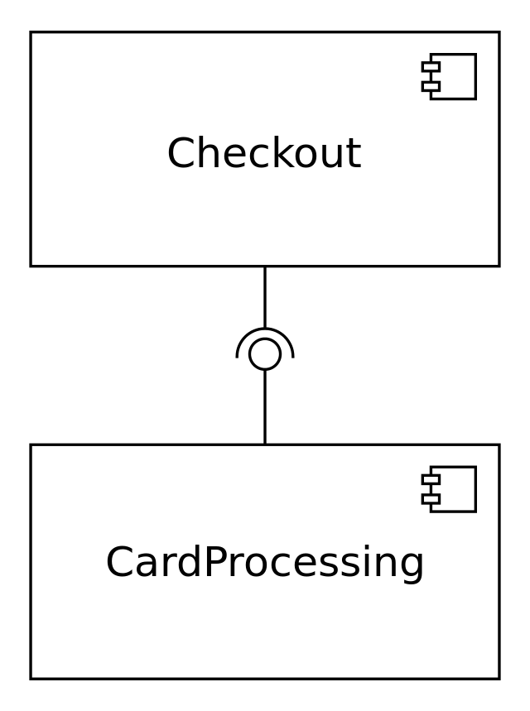
component-oriented programming (COP)
Component-oriented programming is a technique of developing software applications by combining pre-existing and new components, much the same way automobiles are built from other components. Software components are self-contained, self-describing packages of functionality containing definitions of types that expose both behavior and data.
C# supports component-oriented programming through the concepts of properties, methods, events, and attributes (or metadata), allowing for self-contained and self-describing components of functionality.
In a nutshell, object-oriented programming focuses on the relationships between classes that are combined into one large binary executable, while component-oriented programming focuses on interchangeable code modules that work independently and don’t require you to be familiar with their inner workings to use them.

Slide 7
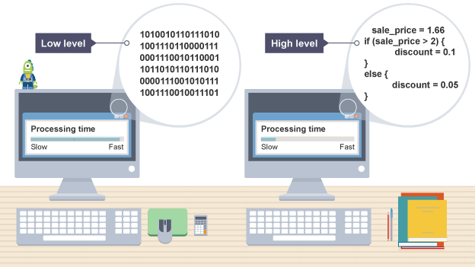
low-level programming vs. high-level programming
A low-level language is machine-oriented. Low-level programs are generally expressed in terms of the machine operations that must be performed to carry out a task. This makes writing programs more difficult, as the algorithm must be specified in terms of the capabilities and specifications of the processor. Today, c and c++ are considered low-level languages due to a lack of memory management– but, again, this is widely debated!
Most programming languages that you will have heard of are high-level languages. A high-level language is one that is user-oriented in that it has been designed to make it straightforward for a programmer to convert an algorithm into program code.

Slide 8

In the old days, C was considered a high-level language. Today, many engineers might laugh at that because C is so low level. C and C++ are now considered low-level languages because they have no automatic memory management.

Slide 9
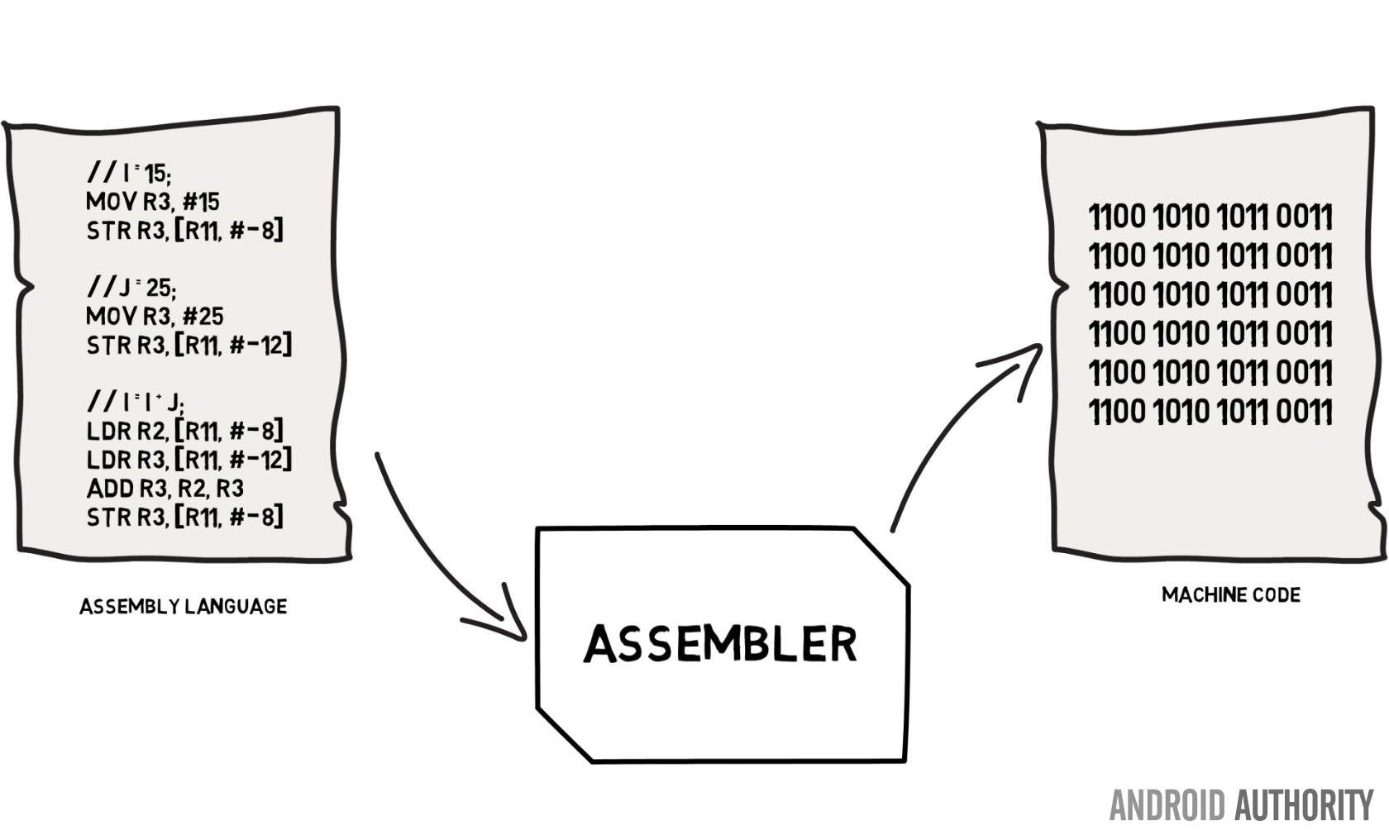

Well, the definition of low-level has changed quite a bit since the inception of computer science. I would not qualify C as a low- or high-level language, but rather more like an intermediary language. The only true low-level programming is machine code or assembly language. Assembly language is as close as possible to what the CPU (the computer's processor) can execute, as it is literally a text translation of the binary code which the CPU understands.
Assembly Language
Machine Code

Slide 10
Well for me, C is low-level because when using it we have to manage our own application memory, it is not managed for us by the language. This requires us as engineers to take total responsibility for our actions. This means our mistakes will tend to be catastrophic, but the rewards are substantial in terms of efficiency and power consumption on whatever device runs our code.

Slide 11
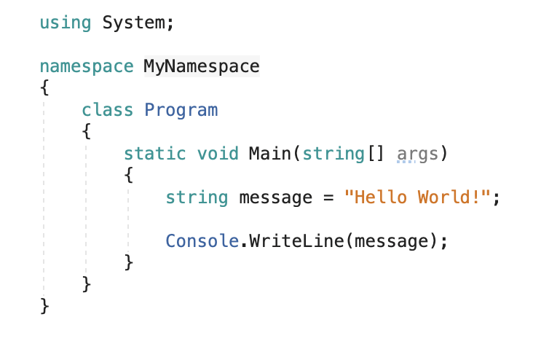
C# vs c++ Key differences: namespaces, classes and methods
using system; imports the system class, which Contains fundamental classes and base classes that define commonly-used value and reference data types, events and event handlers, interfaces, attributes, and processing exceptions.
The Main method is the entry point for every C# application and it's called by the common language runtime (CLR) when the program is started.
The optional default parameter’s (args) elements can be passed in through your cli when executing.
in c#, all Methods are declared in a class, struct, or interface, unlike in c++. (We’ll get to what interfaces are in a bit!)
A namespace is an optional declarative region that provides a scope to the identifiers (the names of types, functions, variables, and so on) inside it. Namespaces are used to organize code into logical groups and to prevent name collisions that can occur especially when your code base includes multiple libraries.

Slide 12
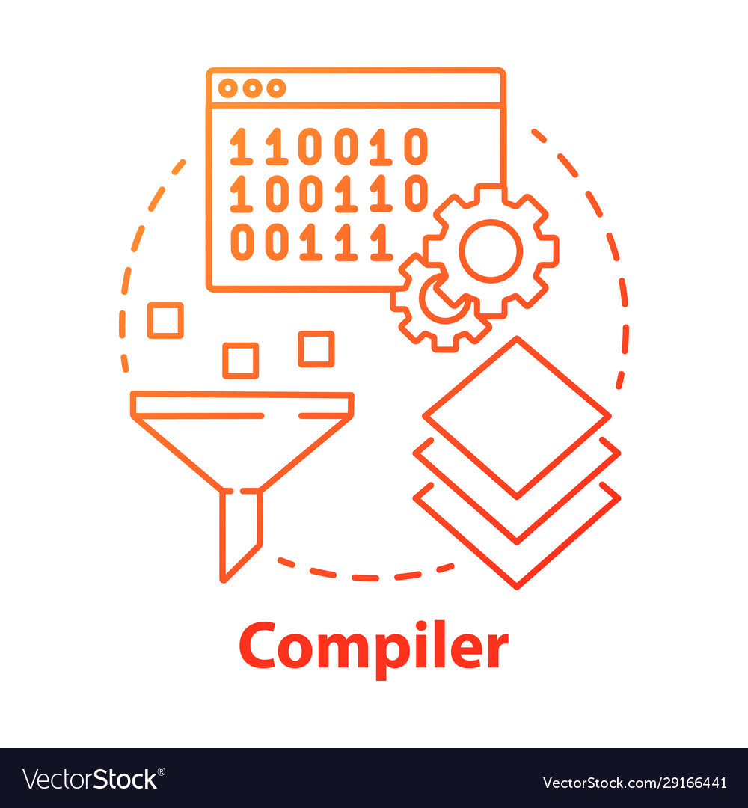
C# vs c++ Key differences: compilation
C++ compiles down to machine code (a low-level language comprised of binary digits– arguably the lowest-level language), whereas C# ‘compiles’ down to CLR (Common Language Runtime), which is interpreted by JIT in ASP.NET.
The Common Language Runtime (CLR), the virtual machine component of Microsoft .NET Framework, manages the execution of .NET programs in different supported languages. C# is compiled to a virtual language which is interpreted by a Virtual Machine.
In computing, just-in-time (JIT) compilation is a way of executing computer code that involves compilation during execution of a program (at run time) rather than before execution.

Slide 13

what is a virtual machine (VM)?
A virtual machine (VM) is a virtual environment that functions as a virtual computer system with its own CPU, memory, network interface, and storage, created on a physical hardware system (located off- or on-premises).

Slide 14

C# vs c++ Key differences: memory management
Memory management in C++ is done manually by the programmer (with dynamic allocation).
Remember, Dynamic memory allocation is the process of assigning the memory space during the execution time or the run time.
C# runs on a virtual machine (VM), which performs memory management automatically.

Slide 15
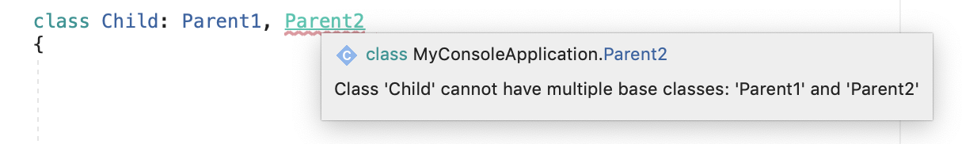
C# vs c++ Key differences: inheritance
C++ supports multiple inheritance.
C# does not offer multiple class inheritance.
(However, it does support multiple interface inheritance…)

Slide 16

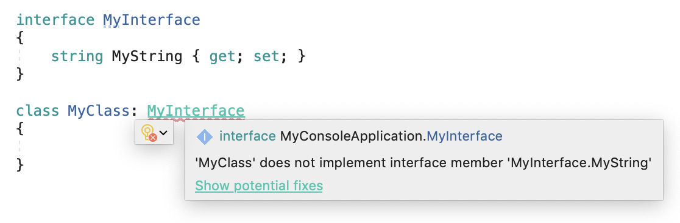
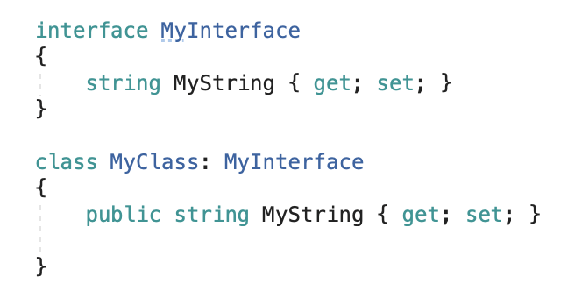
interfaces
An INTERFACE in C# is a type definition similar to a class, except that it purely represents a contract between an object and its user. It can neither be directly instantiated as an object, nor can data members be defined.
Interfaces can contain instance methods, properties, events, indexers, or any combination of those four member types.
(side- note): This bit of code defines this string as a property, not an instance. instances are used to store object state data, and properties are used to set and query object state data.)

Slide 17
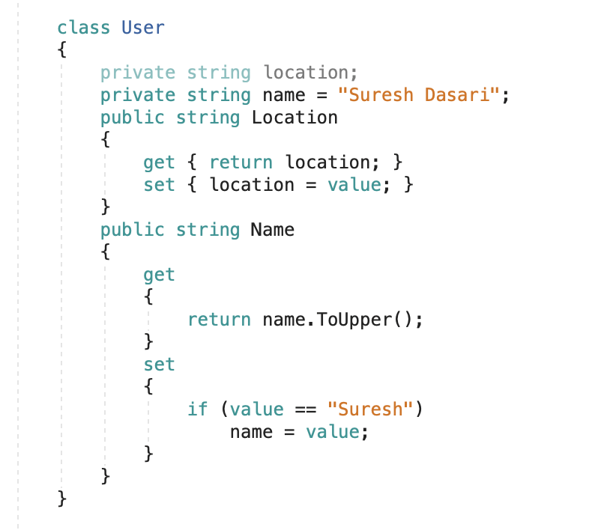
properties
A property is a member that provides a flexible mechanism to read, write, or compute the value of a private field. Properties can be used as if they are public data members, but they have special methods called accessors.
Properties enable a class to expose a public way of getting and setting values, while hiding implementation or verification code, if desired.
A get property accessor is used to return the property value, and a set property accessor is used to assign a new value.
Properties can be read-write (they have both a get and a set accessor), read-only (they have a get accessor but no set accessor), or write-only (they have a set accessor, but no get accessor). Write-only properties are most commonly used to restrict access to sensitive data.
In the example seen here, there are fields above the properties. A field is a variable of any type that is declared directly in a class or struct. Fields are, or course, members of their containing type.

Slide 18
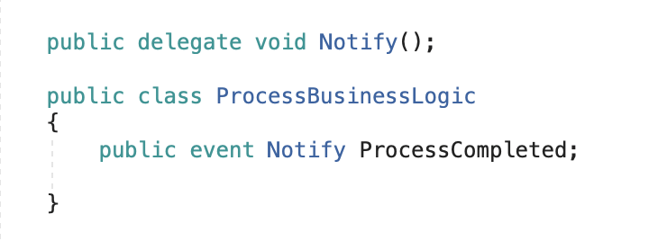
events
an event is a message sent by an object to signal the occurrence of an action. The action can be caused by user interaction, such as a button click, or it can result from some other program logic, such as changing a property's value.
An event sender pushes a notification that an event has happened, and an event receiver receives that notification and defines a response to it.

Slide 19
events
To define an event, you use the Event keyword in the signature of your event class, and specify the type of delegate for the event.
A delegate is a type that holds a reference to a method. A delegate is declared with a signature that shows the return type and parameters for the methods it references, and it can hold references only to methods that match its signature. A delegate is thus equivalent to a type-safe function pointer or a callback.

Slide 20

example event in c#

Slide 21
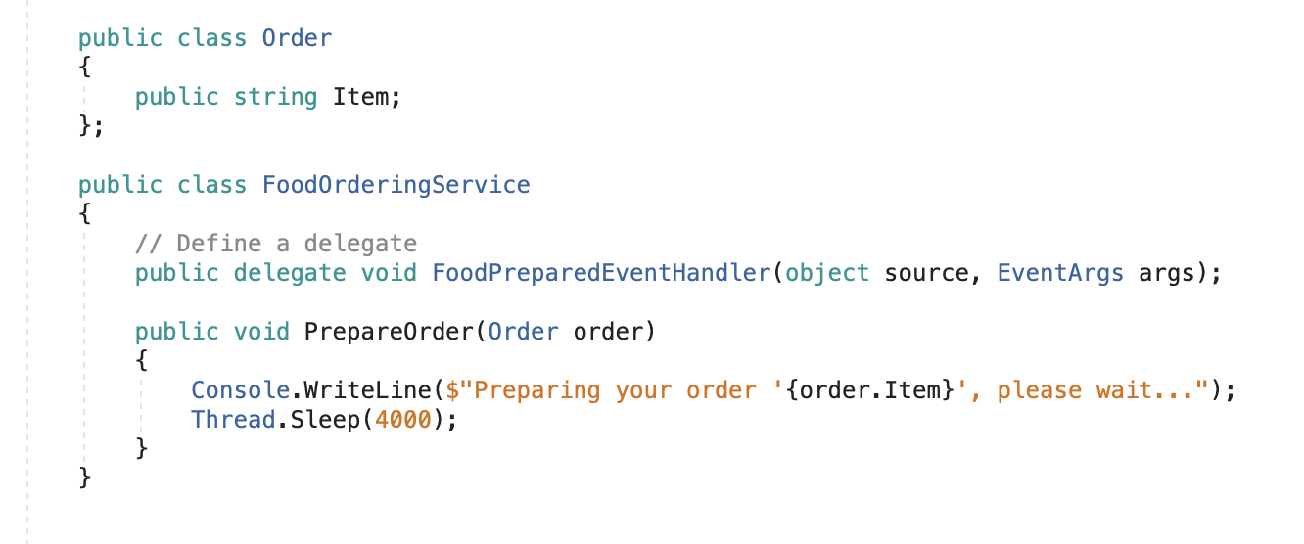
defining a delegate
A delegate is a reference to a method. If we call a delegate, the referenced method is called instead.
Delegates have all the necessary information to call a method or group of methods with a specific signature and return type.
We can pass a delegate as an argument to other methods or we can store it in a structure or a class.
We use delegates when we don’t know which method is going to be called at design time but only during runtime.

Slide 22
defining a delegate
Our delegate returns void, and delegates typically have two parameters. The first one is for the source, or rather the class that will be publishing the event, and the second one is derived from type EventArgs and holds the event data.
If the event does not generate event data, the second parameter is simply an empty eventargs argument. Otherwise, it is a type derived from (a child of) EventArgs and supplies any fields or properties needed to hold the event data.

Slide 23
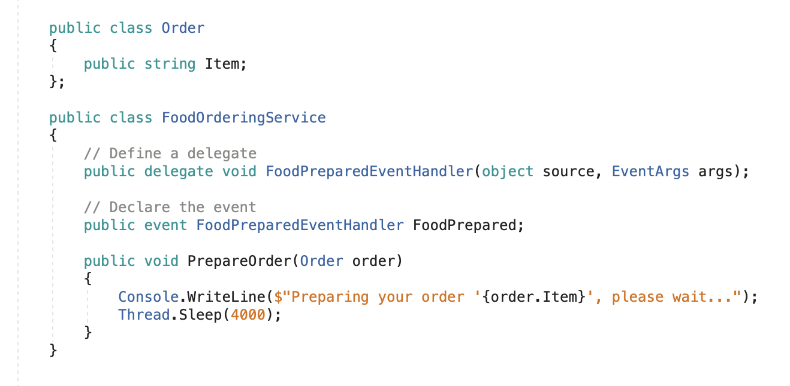
declaring an event
Just a single line!

Slide 24
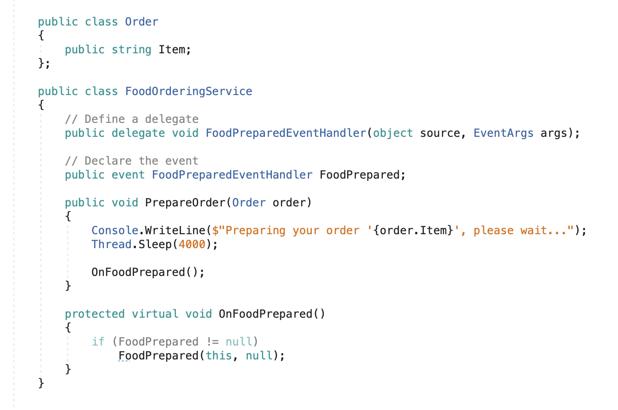
raising the event
Now that we’ve defined our delegate and event, in order to raise an event, we should create an actual handler method!
This method should be protected virtual void by convention.
remember, a virtual method is a method that can be redefined in derived classes!
This method should have an “On” prefix in its name. In the method itself, we check if there are any subscribers and if there are, we call the event and pass on this as an argument, which is the current class, and null as the event arguments (for now).

Slide 25
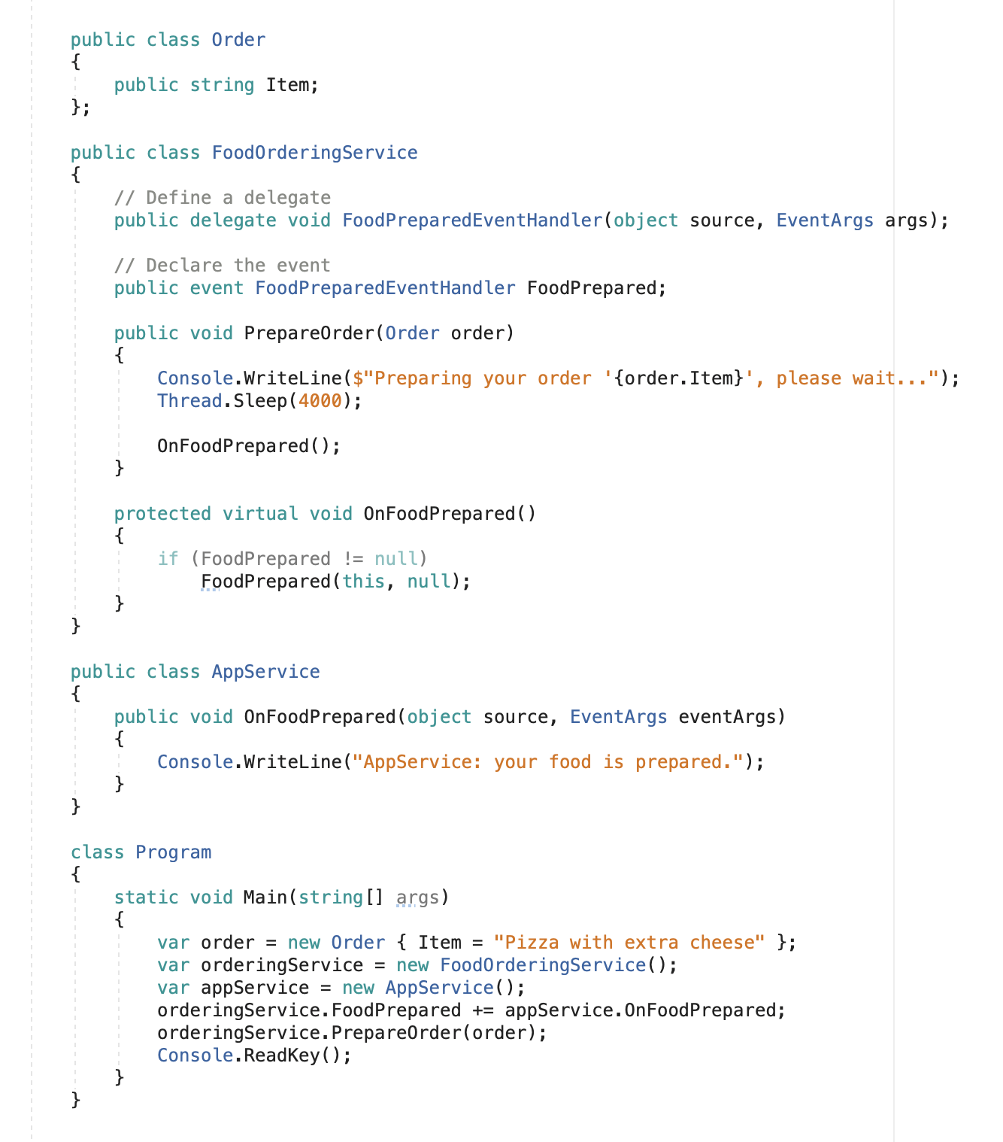
subscribing to the event
We can subscribe to the event by using the += operator, and in our case, we’re subscribing to the FoodPrepared event, and using the OnFoodPrepared method of the AppService class to handle the event.
You can also Use the subtraction assignment operator (-=) to unsubscribe from an event.

Slide 26
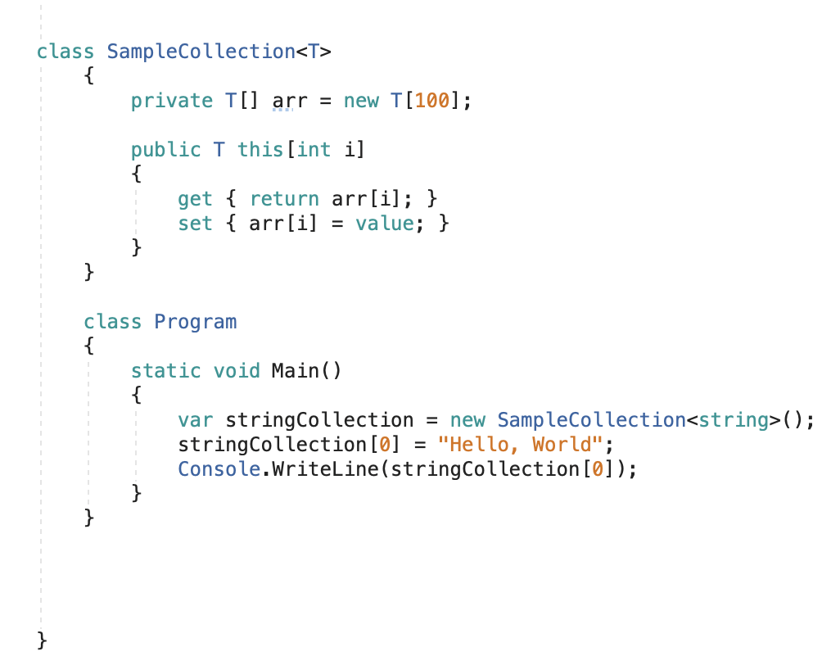
indexers
(The this keyword in C# is used to refer to the current instance of the class.)
Indexers allow instances of a class or struct to be indexed just like arrays. The indexed value can be set or retrieved without explicitly specifying a type or instance member. Indexers resemble properties, except that their accessors take parameters.

Slide 27

C# vs c++ Key differences: pointers
in c#, pointer types are not tracked by the default garbage collection mechanism. For the same reason, In C#, pointers can only be declared to hold the memory addresses of value types (and arrays, which is a reference type).
A data type is a value type if it holds a data value within its own memory space. It means the variables of these data types directly contain values. Some examples of value types are bool, byte, char, decimal, double, enum, float, and many more.
Unlike value types, a reference type doesn't store its value directly. Instead, it stores the address where the value is being stored. Some examples of reference types are strings, arrays, classes, and delegates.

Slide 28
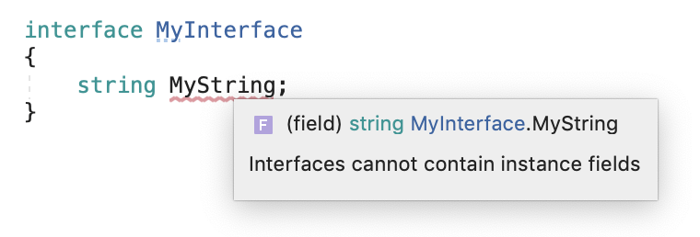
C# vs c++ Key differences: compiler warnings/errors
C++ shows the compiler warning after writing code and compiling them. But in C#, the programmer doesn’t need to worry about compiler warnings. The programmers are informed about errors instantly, thereby allowing them to proceed ahead.
Wait… so Can you cause damage to your computer with c++?
Not if you’re using a modern operating system; you can crash your own program as much as you like, but the OS will insulate everything else from it. This is called process isolation, and it’s a very good thing!

Slide 29
types of errors in c#
Syntax errors: Syntax errors occur during development, when you make type mistake in code. For example, instead of writing while, you write WHILE then it will be a syntax error since C# is a case sensitive language.
Runtime errors (exceptions): Runtime errors occur during execution of the program. These are also called exceptions. This can be caused due to improper user inputs, improper design logic or system errors.
Logical errors: Logic errors occur when the program is written fine and runs, but it does not produce desired result.

Slide 30
var
Some examples of the var keyword:
Local variables can be declared without giving an explicit type. The var keyword instructs the compiler to infer the type of the variable from the expression on the right side of the initialization statement.

Slide 31
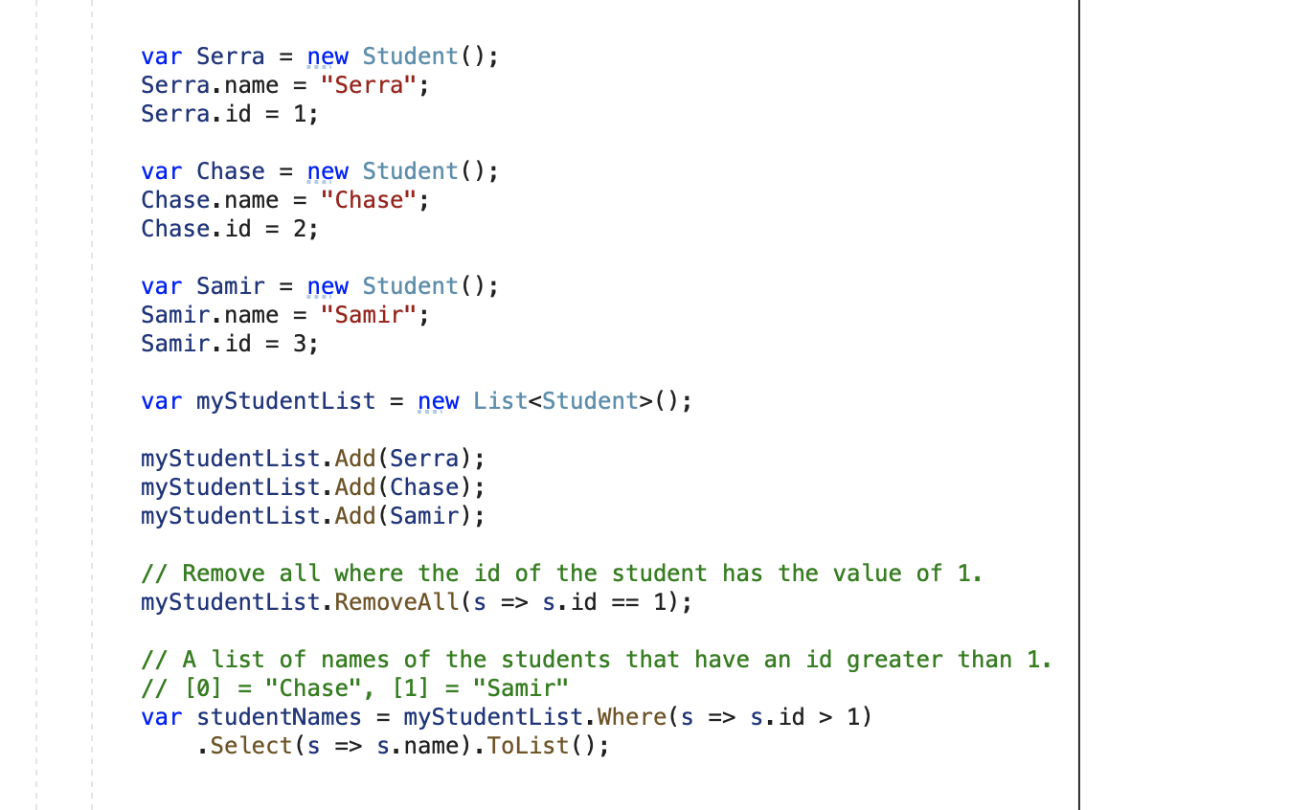
List<T>
A List<T> Represents a strongly typed list of objects that can be accessed by index. Provides methods to search, sort, and manipulate lists.

Slide 32
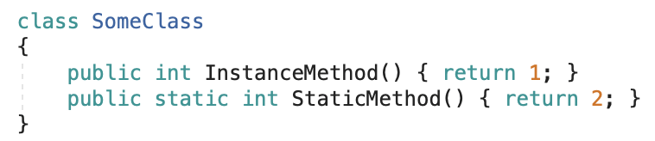
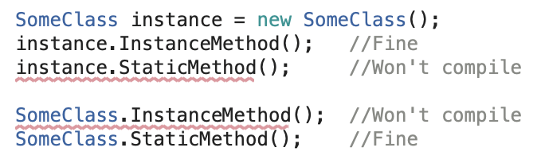
static
Static, in C#, is a keyword that can be used to declare a member of a type so that it is specific to that type. The static modifier can be used with a class, field, method, property, event, constructor and more ... It is mostly used when the data and behavior of a class do not depend on object identity.

Slide 33
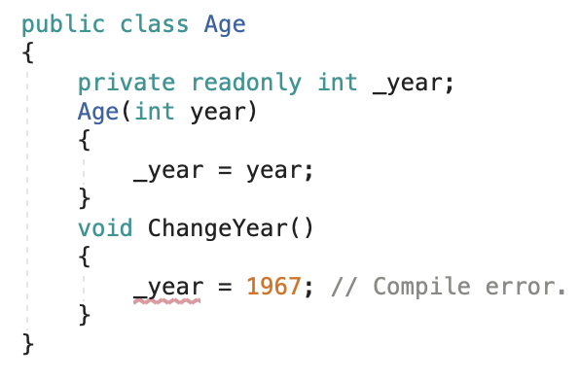
readonly in fields
In a field declaration, readonly indicates that assignment to the field can only occur as part of the declaration or in a constructor in the same class.
A readonly field can't be assigned after the constructor exits. This rule has different implications for value types and reference types:
Because value types directly contain their data, a field that is a readonly value type is immutable (meaning that it can not be changed after it has been created).

Slide 34
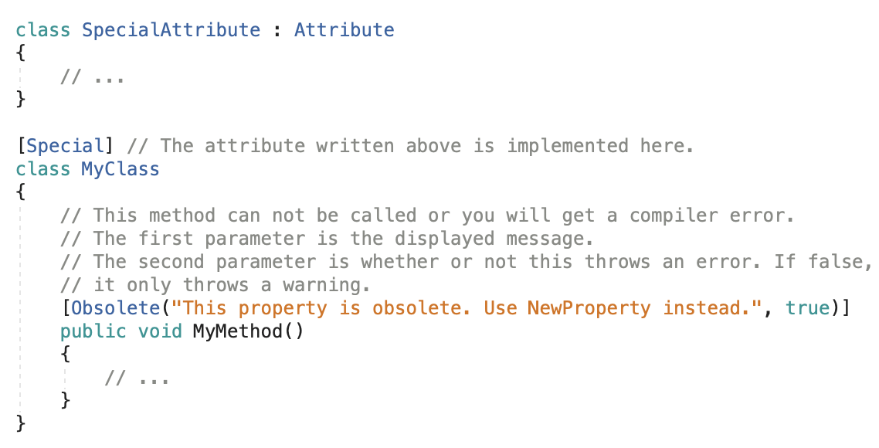
attributes
Attributes provide a powerful method of associating metadata, or declarative information, with assemblies, types, methods, properties, and so forth.
Attributes can be placed on almost any declaration, though a specific attribute might restrict the types of declarations on which it is valid. In C#, you specify an attribute by placing the name of the attribute enclosed in square brackets ([]) above the declaration of the entity to which it applies.
You can even make your own attribute by creating a class that is a child of the attribute class!

Slide 35
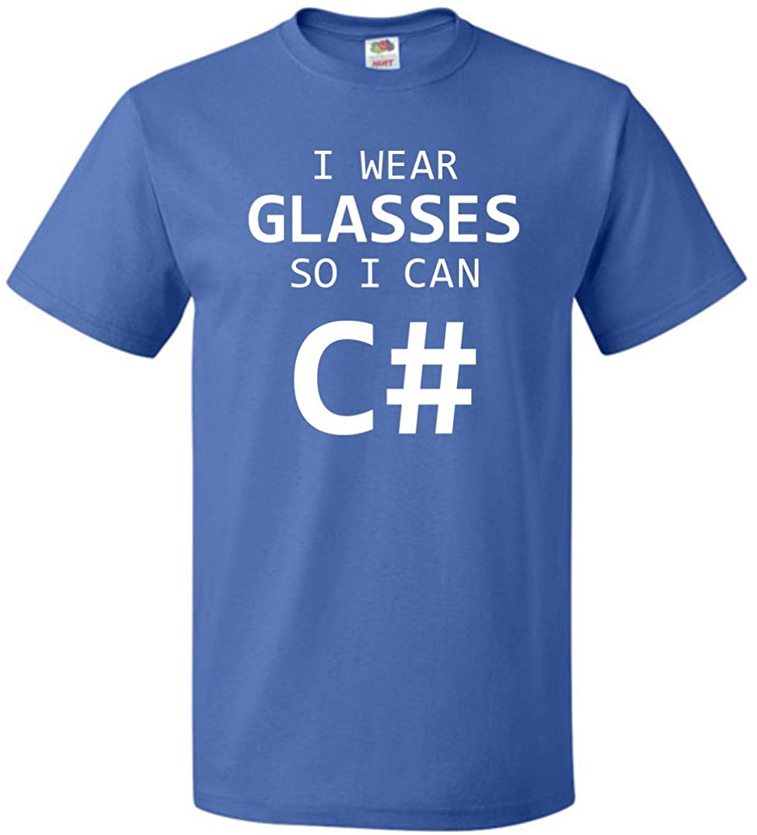
activity # 4
create a console app with a class that has an interface and push it to a git repo! Send me the link to the repository when done.
your class should have at least one interface and three different types of properties.
the interface (and therefore, your class) should have at least three out of these four things:
instance methods, properties, events, indexers.
Make sure you have an instance of this class in main!

